Slide 1

RUBY
Nicholas Vallarelli, Ojonugwa Oji, Verena Barth,
Payal Narkhede, and Vishnu Mullick

Slide 2
Ruby History
Created in Japan in the mid 1990’s
It was designed for programmer productivity with the idea that programming should be fun!
The first public release was Ruby 0.95 that was announced on December 21, 1995 following several updates throughout the following years up until the latest in 2018.
Ruby has a very simple syntax, in many ways similar to Perl and Python.
It is a dynamic and object-oriented scripting language.
Notes:
The use of interpreter rather than compiler is the major difference between a scripting language and programming language.
Ruby uses Interpreter.
Java uses Complier.

Slide 3
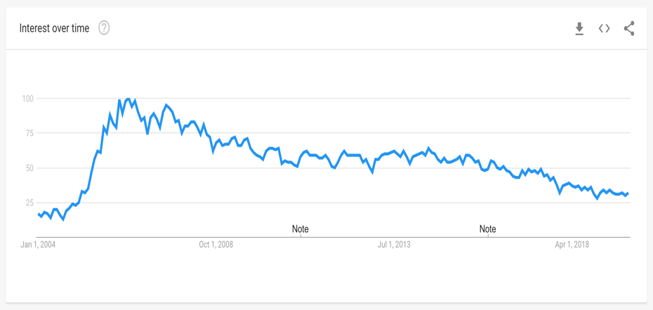
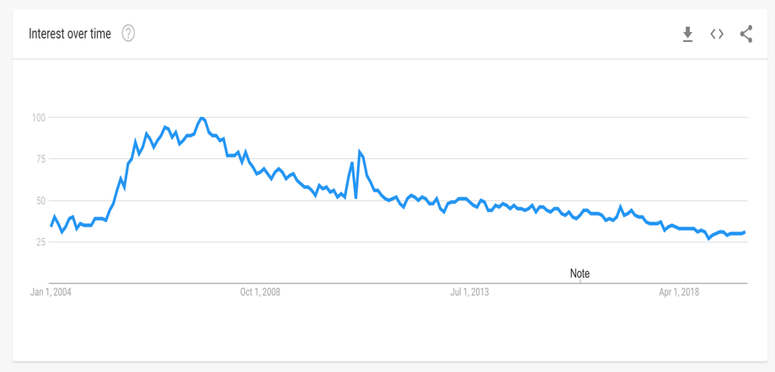

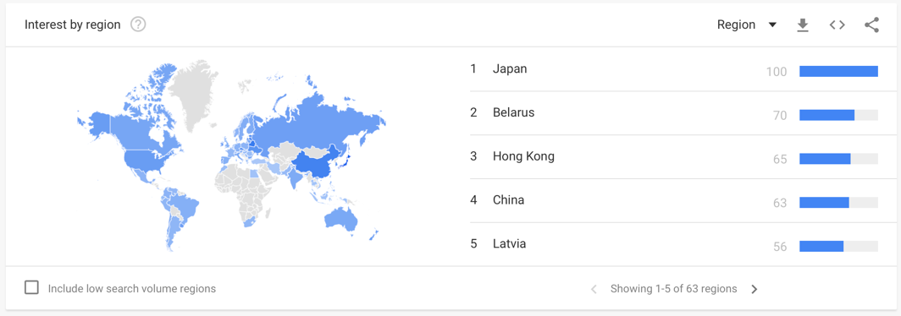
Google Trends: Ruby
United States
Global
Notes:
New York is #7 in the country
United States is #14 in the world

Slide 4
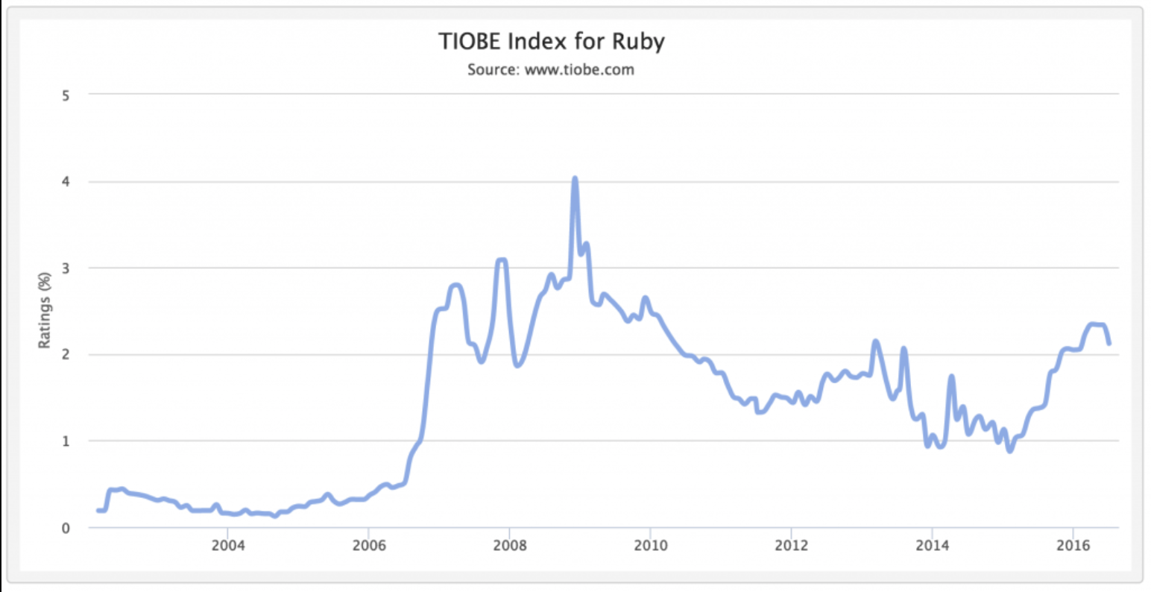
TIOBE: Ruby

Slide 5
Range of Use
Used in the production of multiple websites
Airbnb, Hulu, Kickstarter, GitHub, Fiverr, etc.
Utilized by many different companies
Twitter, Groupon, SoundCloud, Shopify, etc.
Can be used in game programming
Easy to build prototypes for any of your projects
Primarily useful in web applications
One of the most sought after languages by employers
Most sought out language in New York, and the second most in San Francisco and Toronto

Slide 6
Features of Ruby
Open source
Object-oriented
Case-sensitive
Scalable and easy to maintain
Clean and easy syntax
Can be embedded into HTML (eRuby) → Internet development
Notes:
eRuby (Embedded Ruby) is a templating system that embeds Ruby into a text document

Slide 7
Features exclusive to Ruby
Dynamic typing
Code build during runtime
Duck typing
Object’s suitability is determined by the presence of certain methods/properties
Mixins
Dynamic addition of new elements at runtime
Similar to inheritance, but more flexible
Easy database connections with Ruby DBI
Notes:
Dynamic typing:
Ruby programs are not compiled. All class, module and method definitions are built by the code when it runs.
Duck typing:
loosely typed language → variable can hold any type of object
If method gets a parameter which should be a specific object, it determines if the object can be used for the particular purpose
It checks the presence of certain methods and properties, rather than the type of the object itself
(otherwise ArgumentError)
Mixins: Ruby has modules with methods but no instances
Modules can be included into a class to add methods
dynamic addition of new elements of the class hierarchy at runtime
Similar to inheritance, but more flexible
Ruby DBI module provides a database-independent interface, allowing to switch database implementations really easily.

Slide 8
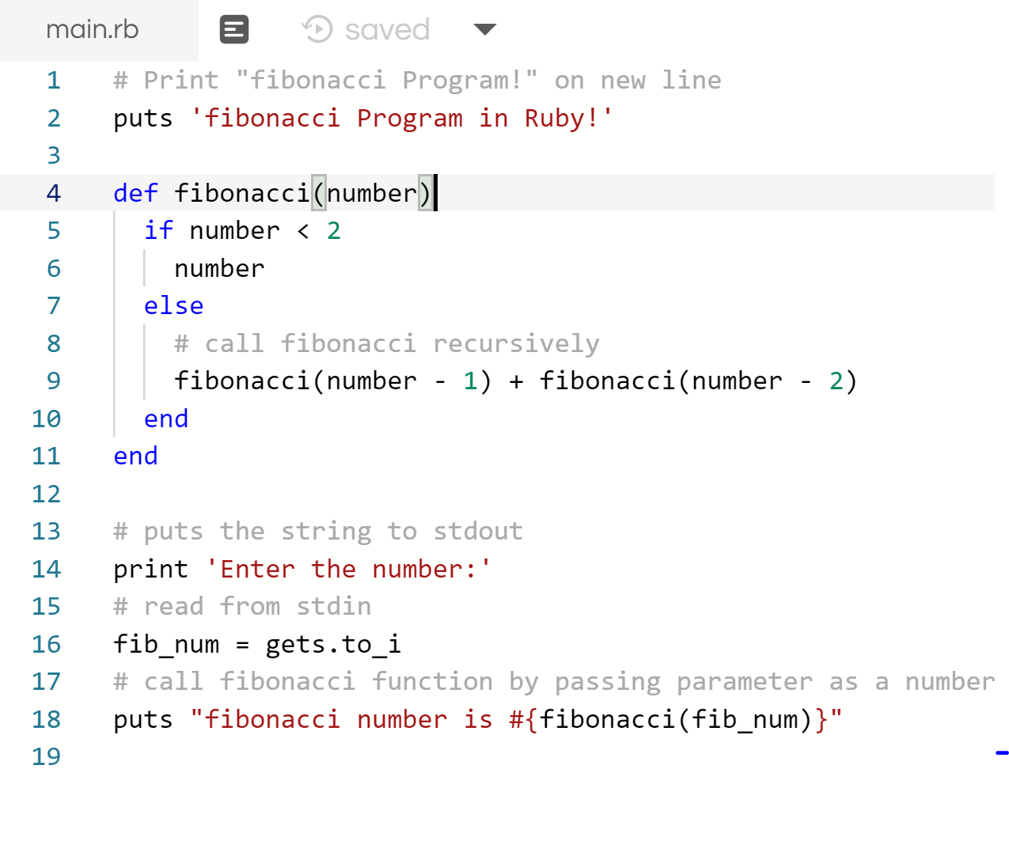
Ruby Source Code
Code Demo
https://repl.it/repls/HotpinkFixedBracket
Repl.it Online Ruby Compiler

Slide 9
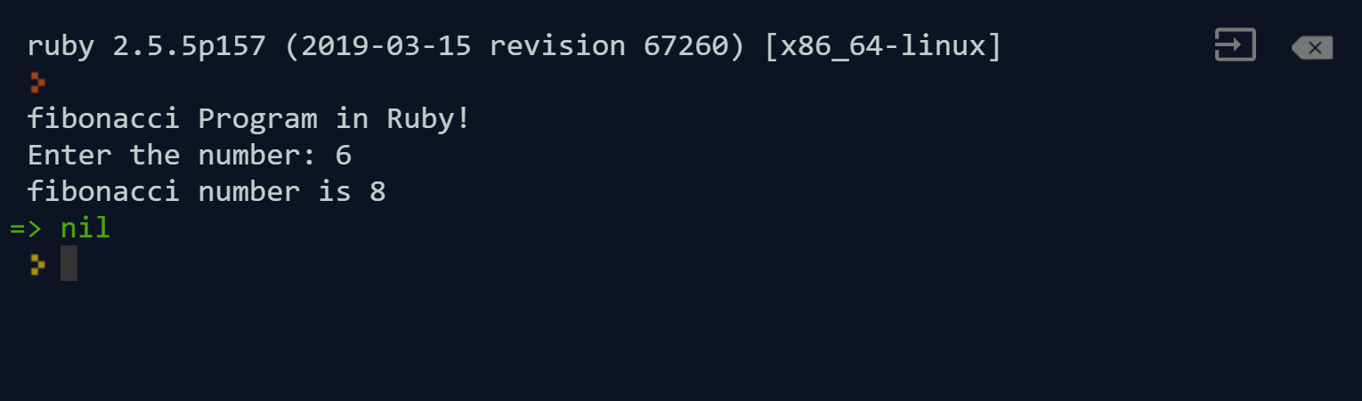
Ruby Code Result

Slide 10
Conclusion
Ruby is a very hands-on language that can be learned easily
Ruby is versatile and is utilized by many large companies
Very simple to learn and can be converted to other languages
Ruby makes programming Fun!

Slide 11
Sources
https://www.coursereport.com/blog/ruby-vs-python-choosing-your-first-programming-language
https://railsware.com/blog/famous-web-apps-built-with-ruby-on-rails/
https://yehudakatz.com/2009/08/24/my-10-favorite-things-about-the-ruby-language
https://www.javatpoint.com/ruby-features
https://yehudakatz.com/2009/08/24/my-10-favorite-things-about-the-ruby-language/
https://www.tutorialspoint.com/ruby/ruby_overview.htm
https://ieeexplore.ieee.org/document/4736789
https://spectrum.ieee.org/view-from-the-valley/at-work/tech-careers/what-programming-languages-engineers-and-employers-loveand-hate

